Slide 1
Face Recognition and Finding
Image Recognition and Understanding Exercise 3

Slide 2
Eigenface
In this exercise, student should report Eigenface construction and Face detection algorithm
From the dataset (pgm format), you should use all images (400 images).
Please report below
A list of all face images
Average face
Higher dimensions (1-50) of Eigen Face
3 selected face for Eigen face reconstruction from 1 – 50 dimensions (please select 1 of glass-wore face c.g. s6/3.pgm)
Dataset: https://www.dropbox.com/s/nfywhly80jr22rj/att_faces.zip?dl=0

Slide 3
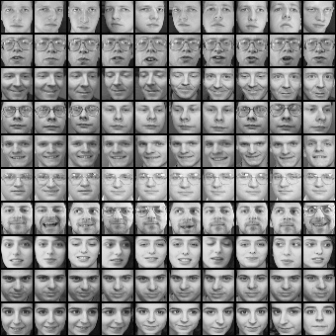
Eigenfaces example
Training images
Notes:
3

Slide 4
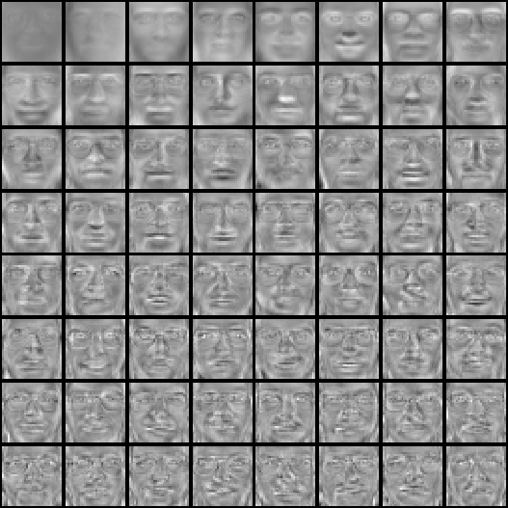
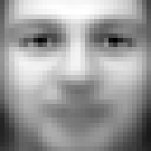
Eigenfaces example
Top eigenvectors: u₁,…u_{k}
Mean: μ
Notes:
4

Slide 5
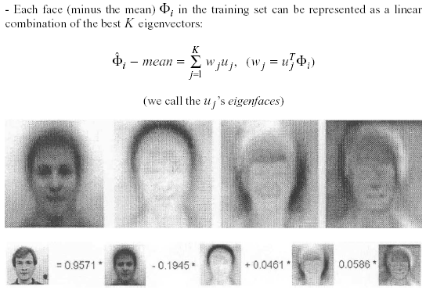
Application to Faces
Representing faces onto this basis
Face reconstruction:

Slide 6
Face Detection
Please construct your face-detection algorithm
You can use Eigenface algorithm for it.
You can also use some other algorithms which installed or written in OpenCV or Matlab
Please report what algorithm did you use and how to use it.
Please report your result with 3 or more images on dataset
Dataset: https://www.dropbox.com/s/vq1vcpbt6sim4av/SelectFaces.zip?dl=0

